Slide 1

Dynamic Generation of Modular Industrial Plant Visualizations
Weekly Meeting 10
Miguel Romero Karam

Slide 2
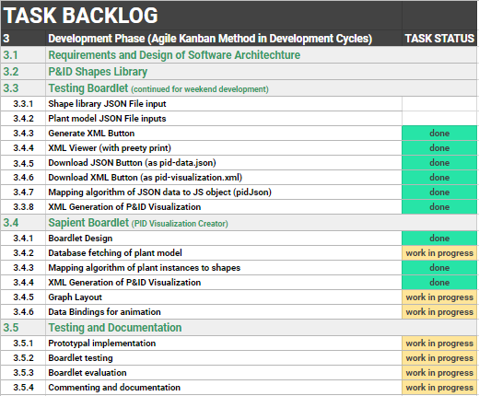
Task Backlog – Overview Overview of tasks: Week 10

Slide 3
Task Backlog – Overview Overview of tasks: Week 10

Slide 4
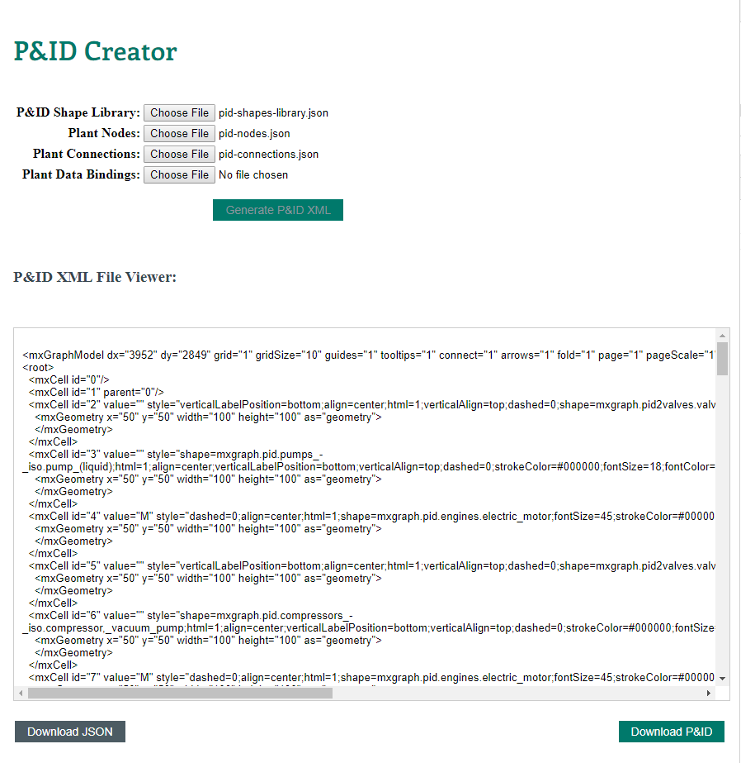
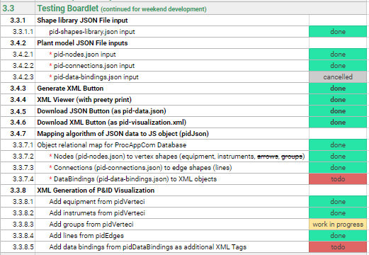
Testing Boardlet Weekly Sprint 10
In client- background

Slide 5
Task Backlog – Overview Overview of tasks: Week 10

Slide 6
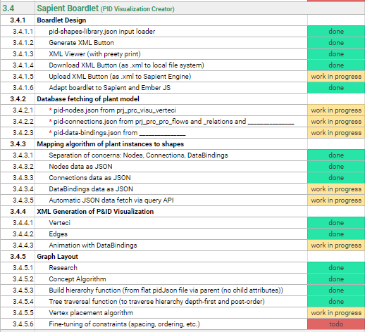
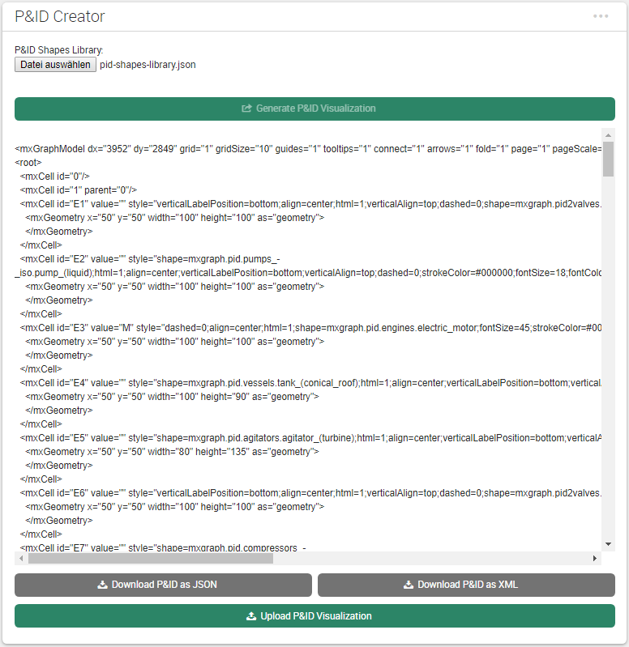
Sapient Boardlet Weekly Sprint 10
UPDATE

Slide 7
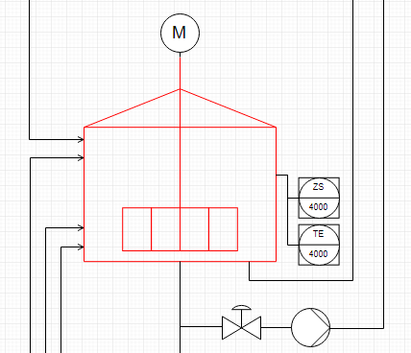
3.4.8 – Vertex Layout Algorithm Concept
Instance Hierarchy Traversal
Instance Hierarchy in model via parent attribute.
Once cModule layer reached, work with place all inside parent.
When done, move to parent’s next children.
Repeat.
Enterprise : AIDA Cruises
1
Site : AIDA
2
Area : Brewery
3
Brewhouse : Process Cell
4
Unit : U_L2
5
U_M5
1
U_P3
5
U_W3
1
EModule : Water_injection
6
Stem_ heating
11
16
…
…
…
…
…
…
…
…
…
…
…
…
…
CModule :
6
7
8
9
10
12
13
14
15
…
…
…
…
…
…
…
Control_valve_440
Pump_P40
Motor
Kettle_sensor_Z
Kettle_sensor_T

Slide 8


3.4.8 – Vertex Layout Algorithm Concept
Vertex Placement
Depth-first traversal of instance hierarchy (IH) via parent attribute until cModule.
Vertex placement inside group: relative positioning with constraints
Rules for example: if (valve to instrument) : instrument above valve
Implement units and cModules as groups (containers) with mxGraph API.
Count units to construct general grid layout.
Geometry between neighbouring children
$$x=w_{p}+s$$
y$=h_{p}−$ $h_{n}$
wn/2
wp/2
(x, y)
hn/2
hp/2
(0, 0)
spacing
Hgmax (currently)
$$r$$
Wgmax (currently)
Relative Positioning
vertex placement group placement group placement … (recursively)
Parent vertex
(0, 0)
(-0.5,0.5)
(0.5, 0.5)
(1, 1)

Slide 9
Issues and challenges Weekly Sprint 10
Connection to Database
Problem: Tables not in repository
Solution: Added tables to Repository via LC2

Slide 10
Next Sprint – ToDos Weekly Sprint 10
Boardlet Design
Fix floating buttons (side-by-side)
Root node selection also for multiple (with parameters.nodeList)
Design of root-node-selection input field
Build Hierarchy Function
Fix to start from selected root node (to work out for multiple)
Database queries
Connect remaining tables to repository with LC2 (instructions in daily-routine notes)
getData() generic Function
pidRootNode name query (to display in input field on updateInput())
pidNodes parameter definition
pidConnections parameter definition
Process Variables parameter definition
Animations via sapient-bind
Documentation and Commenting
Modularization of code
JsDocs
Testing

Slide 11
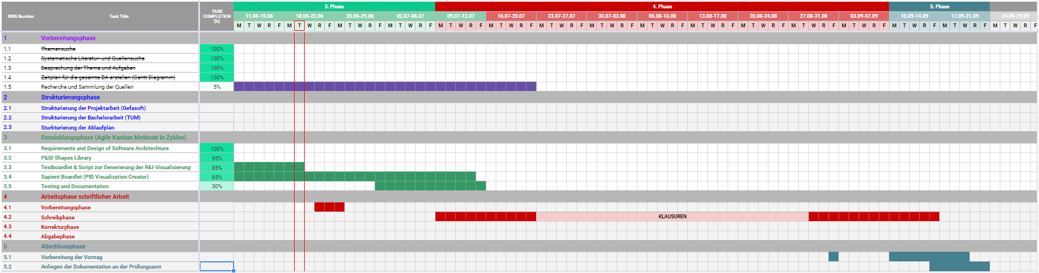
Project – Overview Overview of tasks: Week 10

